Slide 1
CSCIU 210 Computer Organization AKM Jahangir A Majumder, PhD
Fall 2018 - Lecture 12
September 21, 2018
Note: Some slides are adapted from those used by previous instructors and some slides include figures from the textbook.

Slide 2
Review and Learning Outcomes
We will continue to cover Circuits and Number Systems
So far, we covered the following topics
Fundamental digital blocks: AND, OR, and NOT gates
Boolean algebra
Base conversion between different number bases
We will begin to cover how to do math in the binary format and how to implement it in hardware
The binary math we learn will be used to build arithmetic logic unit (ALU)
Key for Homework 2 is posted on Blackboard
We will have quiz 2 today, which will cover lectures 5-9

Slide 3
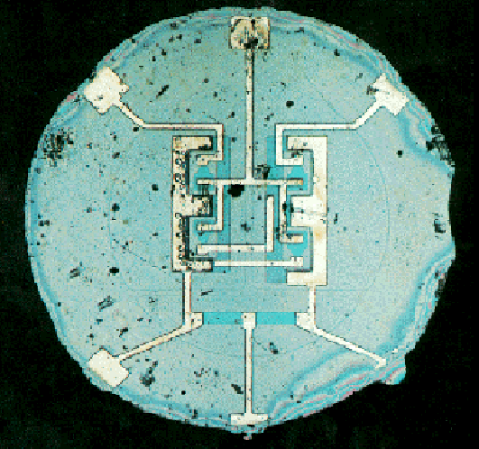

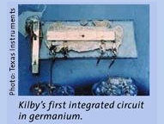
The Integrated Circuit (IC)
An IC consists of interconnected electronic components in a single piece (“chip”) of semiconductor material.
In 1958, Jack S. Kilby (Texas Instruments) showed that it was possible to fabricate a simple IC in germanium.
In 1959, Robert Noyce (Fairchild Semiconductor) demonstrated an IC made in silicon using SiO₂ as the insulator and Al for the metallic interconnects.
The first planar IC
(actual size: 0.06 in. diameter)

Slide 4
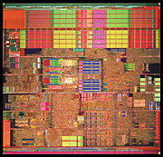
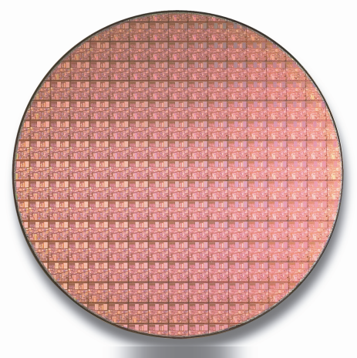
From a Few, to Billions
By connecting a large number of components, each performing simple operations, an IC that performs very complex tasks can be built.
The degree of integration has increased at an exponential pace over the past ~40 years.
The number of devices on a chip doubles
every ~18 months, for the same price.
Intel Pentium®4 Processor
“Moore’s Law” still holds today.
300mm Si wafer

Slide 5
Constructing Gates
Transistor A device that acts as a switch, either open or closed (on or off)
A transistor has no moving parts, yet acts like a switch
It is made of a semiconductor material, which is neither a particularly good conductor of electricity, such as copper, nor a particularly good insulator, such as rubber

Slide 6
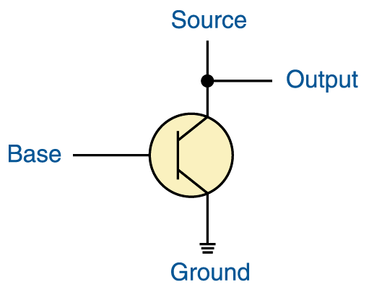
Constructing Gates
Transistor terminals
Source
Base
Emitter
If the electrical signal is grounded, it is allowed to flow through an alternative route to the ground (literally) where it can do no harm

Slide 7
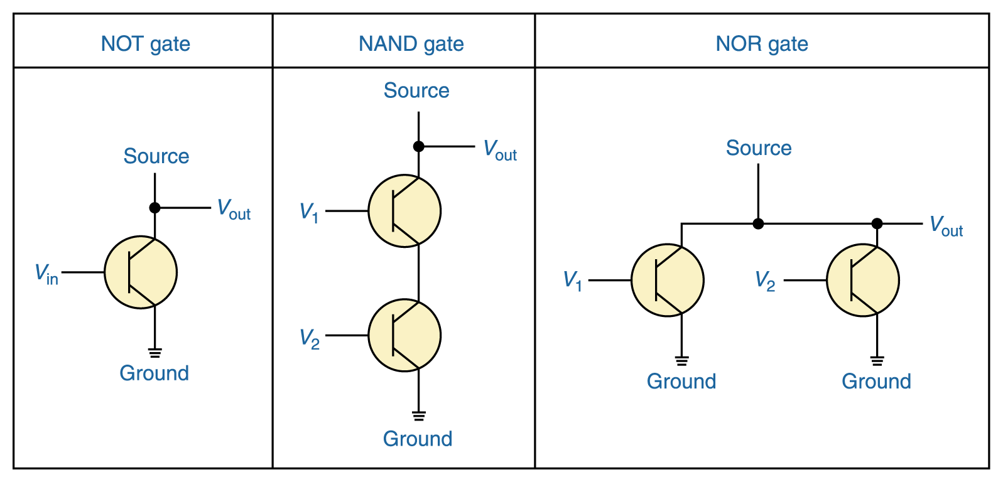
Constructing Gates
It turns out that, because the way a transistor works, the easiest gates to create are the NOT, NAND, and NOR gates

Slide 8
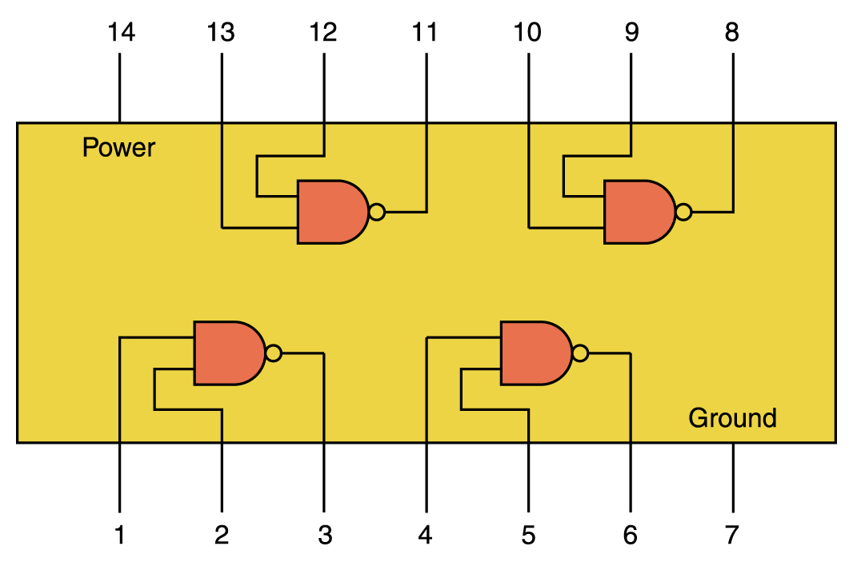
Integrated Circuits
An simple chip containing 4 independent NAND gates (about 8 transistors)

Slide 9
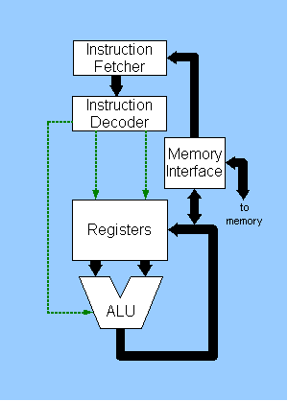
Integrated Circuits
A simple Central Processing Unit, or CPU has an ALU and other things

Slide 10
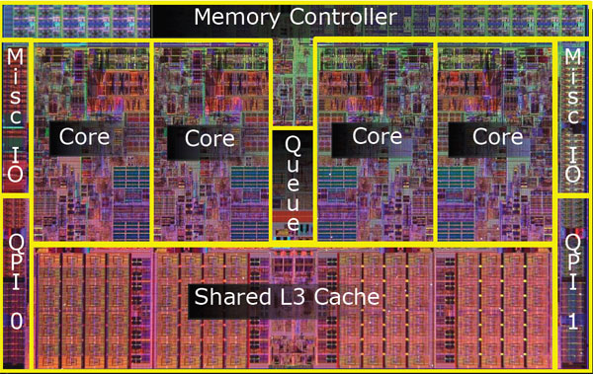
CPU Chips
A recent CPU chip (Intel Nehelem) 731 Million transistors

Slide 11
Where are we?
So far, we covered the following topics
Fundamental digital blocks: AND, OR, and NOT gates.
Boolean algebra.
Base conversion between different number bases.
We will begin to cover how to do math in the binary format and how to implement it in hardware.
The binary math we learn will be used to build arithmetic logic unit (ALU).

Slide 12
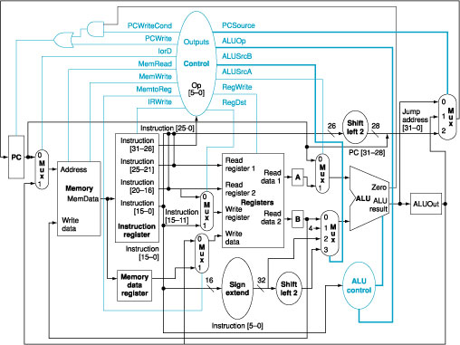
ALU in a MIPS Computer
ALU

